Slide 1
Curriculum Night 2018-2019
Frau Schott and Frau Hölper

Slide 2
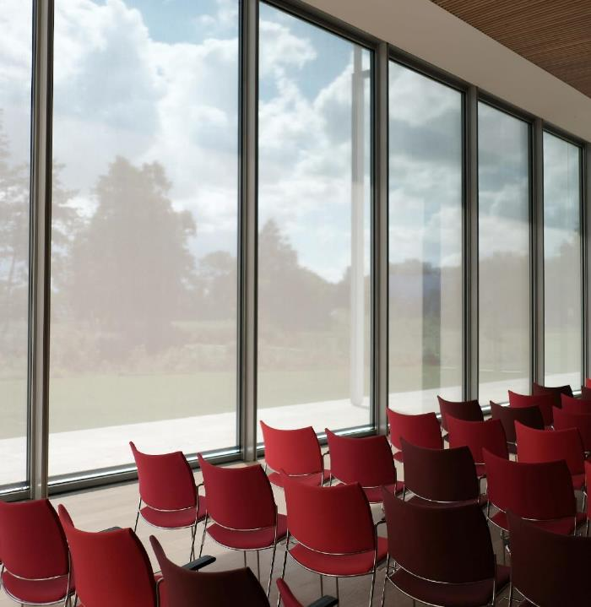
Our Weebly pages frauschott.weebly.com frauholper.weebly.com
PLEASE CHECK WEEBLY PAGES ON A REGULAR BASIS!

Slide 3
General information formal grades 60% (announced) informal grades 40 % (unannounced) Transportation changes: transportation.waddell@cms.k12.nc.us Attendance: attendance.waddell@cms.k12.nc.us

Slide 4
Procedures
Homework: Due in the morning; when absent homework needs to be turned in the next day students are present
Communication folder: check DAILY for forms/letters and homework assignments
Tardies/Early dismissal: Send email in advance and avoid during English if possible (11:45-12:45)
Classroom library checkout
German reading: 10-15 minutes daily
Frau Schott
Frau Hölper
Rewards for completing a worksheet while reading
Homework lottery tickets
Reading log → 10-15 minutes every day in German
4

Slide 5
Online resources – NCEdCloud
NCEdCloud
Powerschool (grades) → letters with access information were sent home
Clever
Pearson
Studies Weekly
Learning A-Z
Discovery Education
Quizlet https://quizlet.com/subject/Frau-Schott/
DyKnow Monitoring tool for student online activities
5

Slide 6
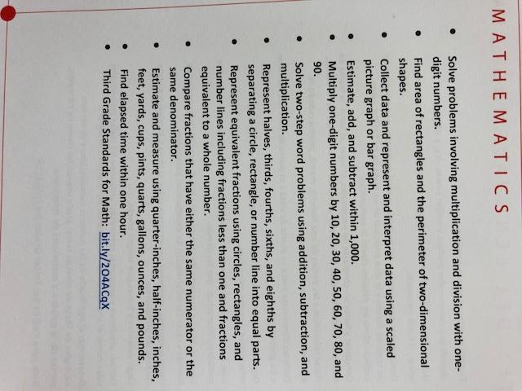
What students will learn this year
6

Slide 7
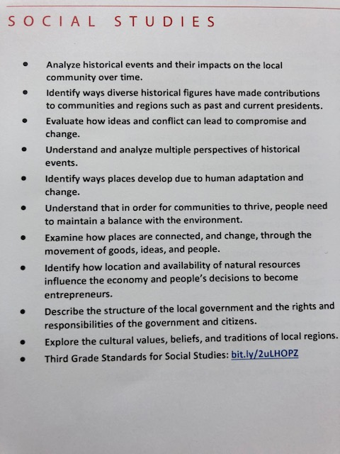
What students will learn this year
7

Slide 8
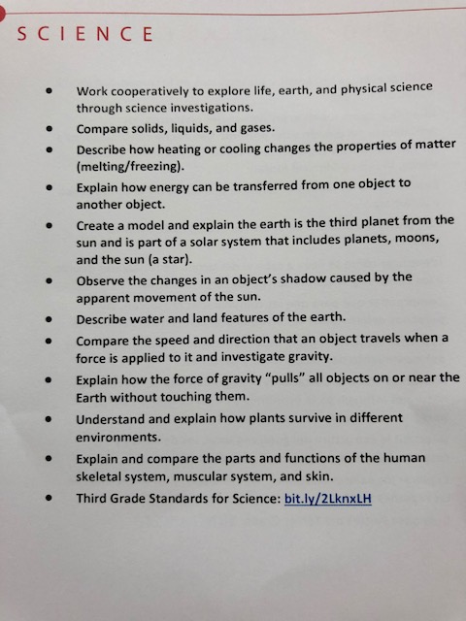
What students will learn this year
8

Slide 9
THANK YOU
Frau Schott Frau Hölper
Cindy1.schott@cms.k12.nc.us sylvia1.holper@cms.k12.nc.us
frauschott.weebly.com frauholper.weebly.com

